Slide 1

OPTIMIZING PUBLIC TRANSIT OPERATIONS
An Exploratory Data Analysis of public transportation

Slide 2



MetroMove Transit Solutions is a public transportation service provider operating in multiple cities.
They manage and analyze thousands of daily trips taken via buses, trains, ferries, and trams.
The company's mission is to provide efficient, affordable, and timely public transportation services while leveraging data to improve passenger experience and optimize operations.
-- Business Introduction and Rational --

Slide 3
Effective decision-making relies on
Understanding passenger usage patterns.
Evaluating the performance of different transport modes.
Analyzing how trip characteristics impact customer experience.
This project provides a real-world simulation by
Requiring cleaning and preprocessing of raw data.
Encouraging pattern discovery through exploratory data analysis.
Developing skills in communicating data-driven insights.
Working within the context of a transportation-focused dataset.

Slide 4

Clean, explore and summarise trip records to identify inefficiencies and patterns that can drive operational improvements
Analyse a large volume of trip data to create insight into trip performance, passenger behaviour, and fare patterns.
-- Problem Statement --

Slide 5

-- Data Cleaning and Preparation ---
Unwanted data columns dropped:
Trip ID, Unnamed:10 & Unnamed: 11
Columns with Missing Data
Passenger Count, Fare Amount & Trip Duration per Minute
Replaced Missing data with the median
Inconsistencies with columns:
Mode of Transport, Departure Station & Arrival Station
No duplicates in the datasets

Slide 6
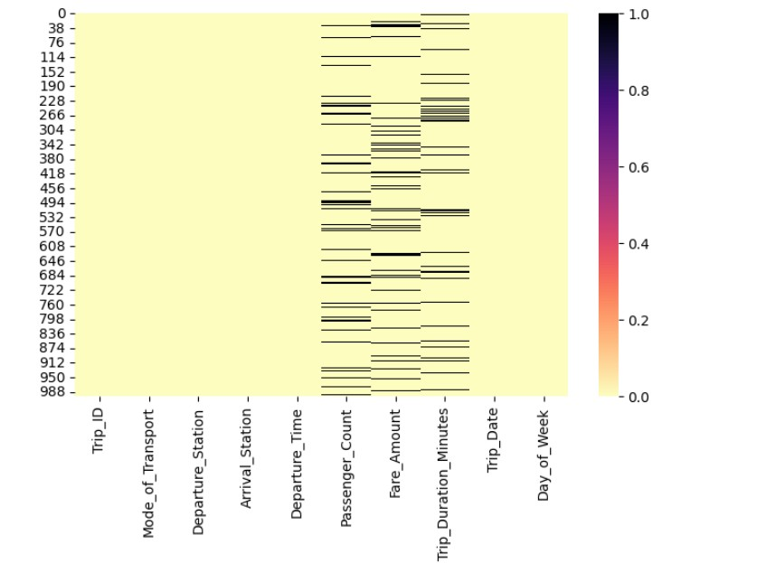
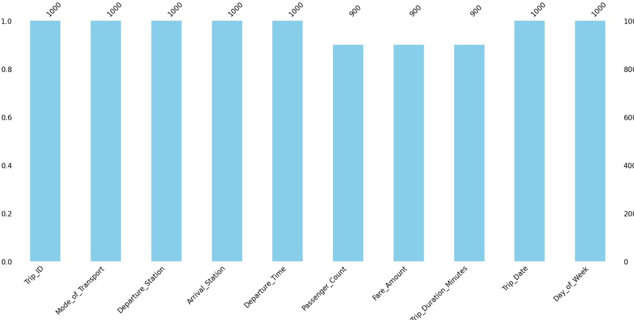
--Visualization of Missing Data--

Slide 7
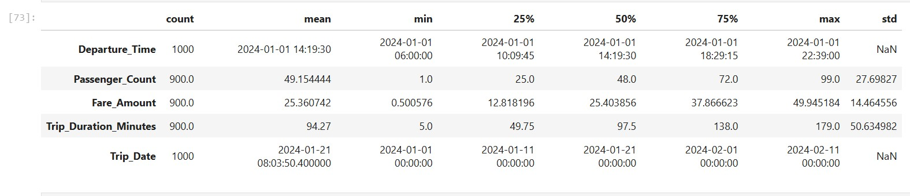
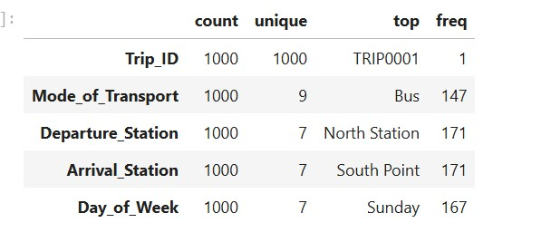
-- Descriptive Statistics --
Numerical Variables
Categorical Variables

Slide 8
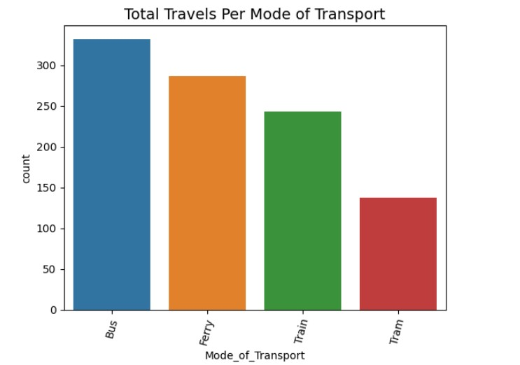
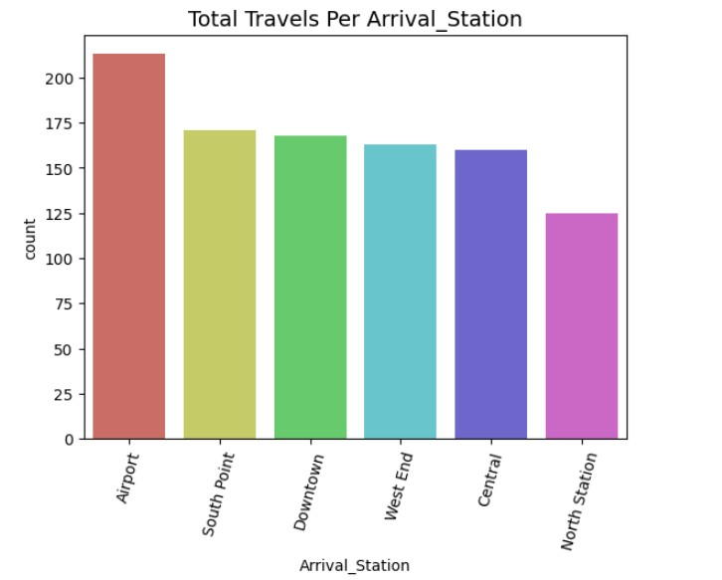
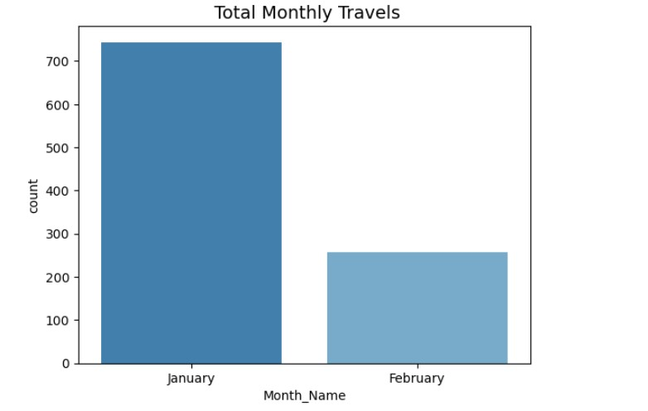
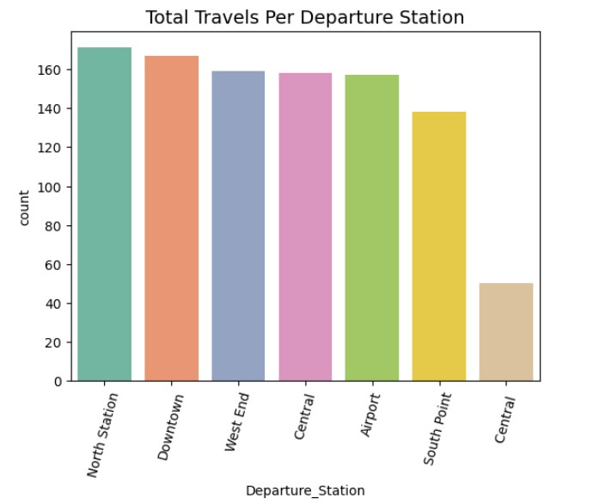
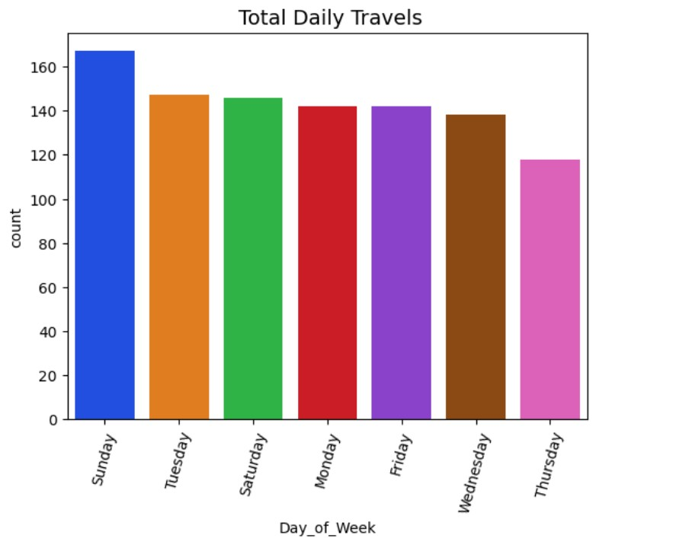
Categorical Visualization
Univariate Analysis

Slide 9
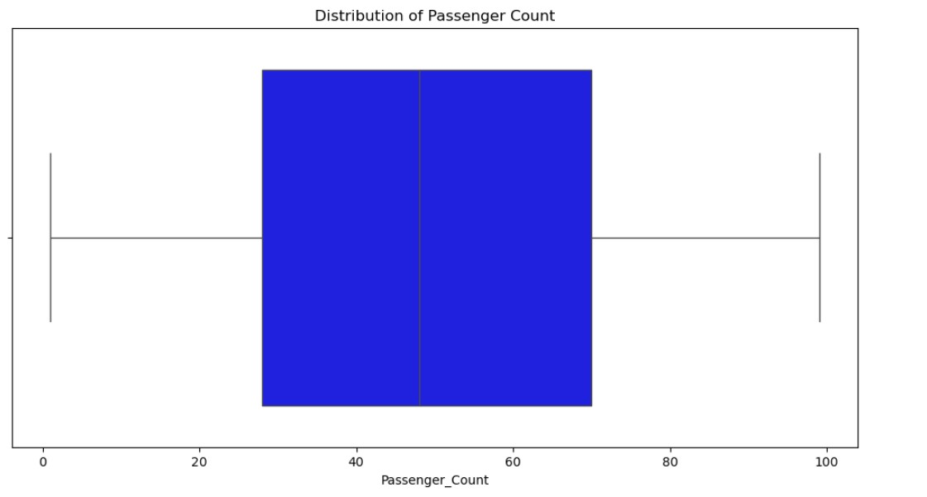
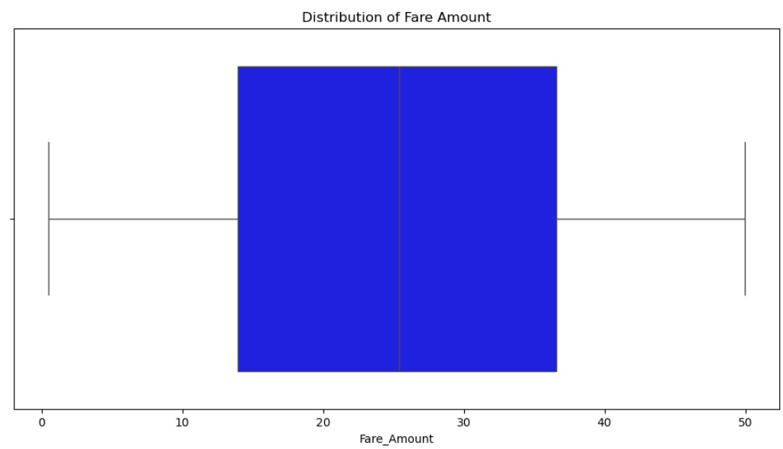
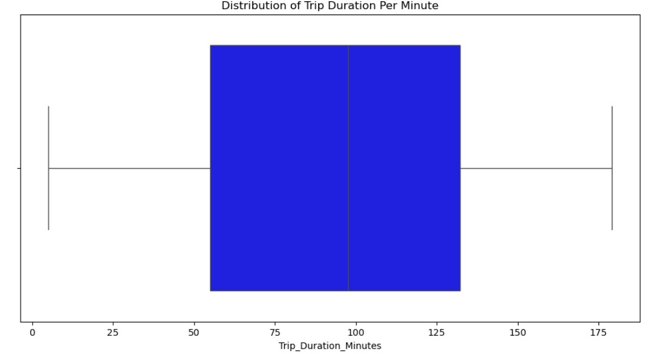
Numerical Visualisation
Distribution of Passenger Count
No Outliers
Upper Quartile and Lower Quartiles
Median
Symmetry
Passenger Count Range
Distribution of Fare Amount
No Outliers
Upper Quartile and Lower Quartiles
Median
Symmetry
Fare Amount Range
Distribution of Trip Duration Per Minute
No Outliers
Upper Quartile and Lower Quartiles
Median
Symmetry
Trip Duration Per Minute Range

Slide 10
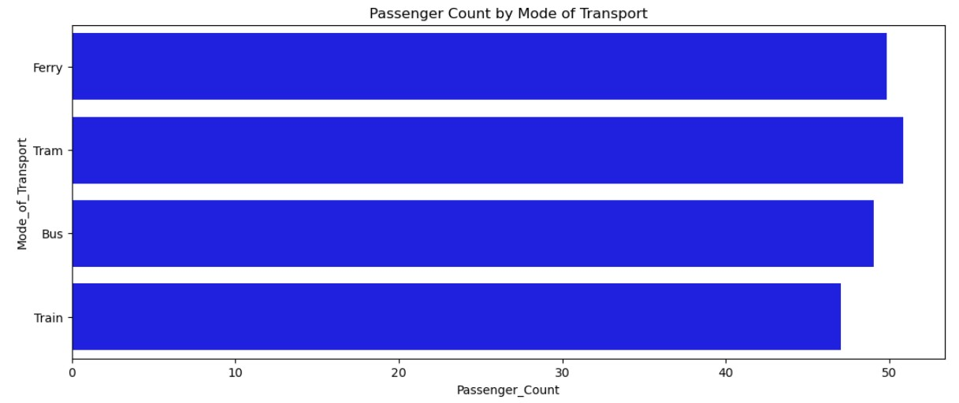
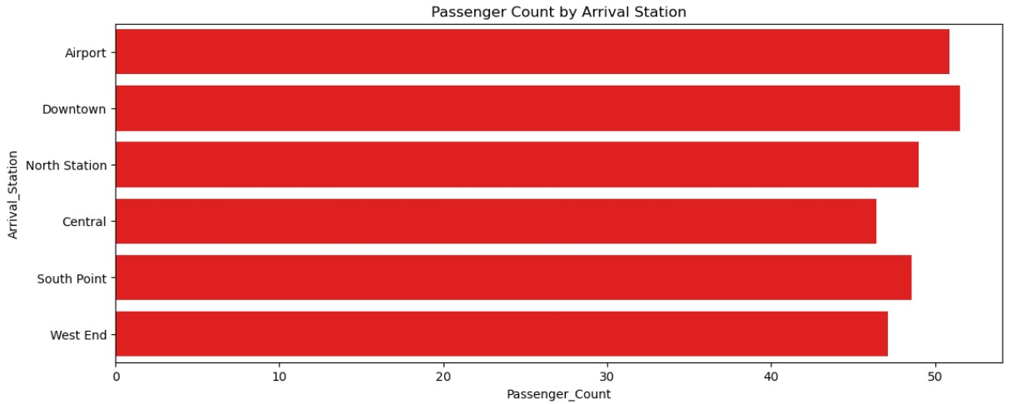
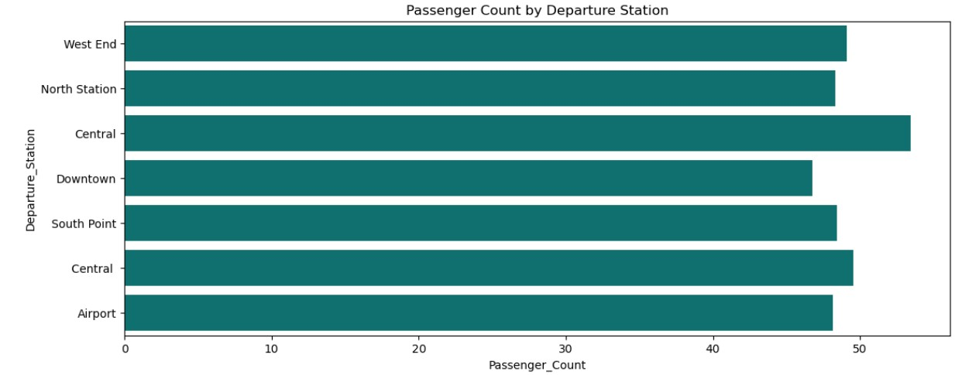
Bivariate Analysis
Passenger Count By Mode of Transport
Passenger Count By Arrival Station
Key Insights include:
Leading Passenger Count
Decline at Other Stations
Station Ranking
Passenger Count By Departure Station

Slide 11
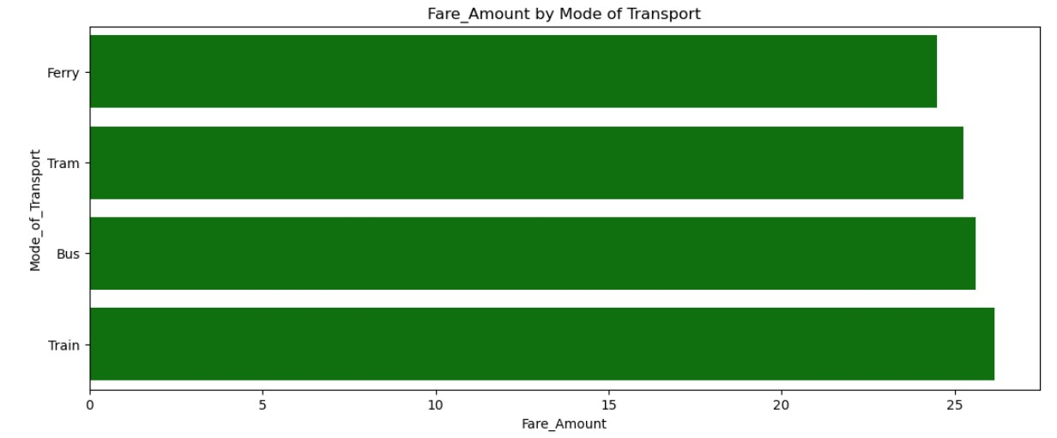
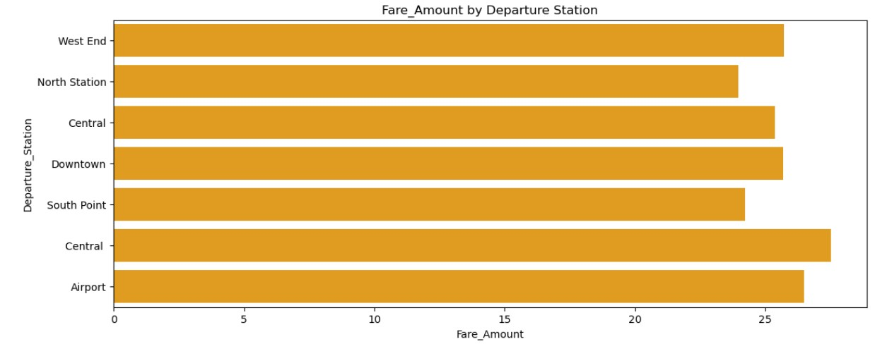
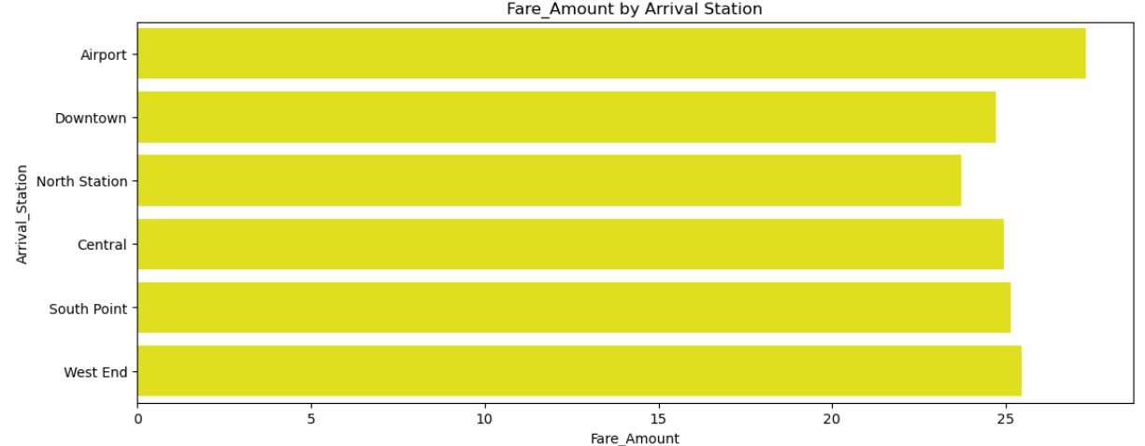
Fare Amount By Mode of Transport
Fare Amount By Departure Station
Central – Highest Fare
Airport - second highest
Downtown and West End
South Point and North Station - lower fares
Fare Amount By Arrival Station
Highest Fare: Airport
Downtown and West End
Central, South Point, and North Station
Narrow Fare Range

Slide 12
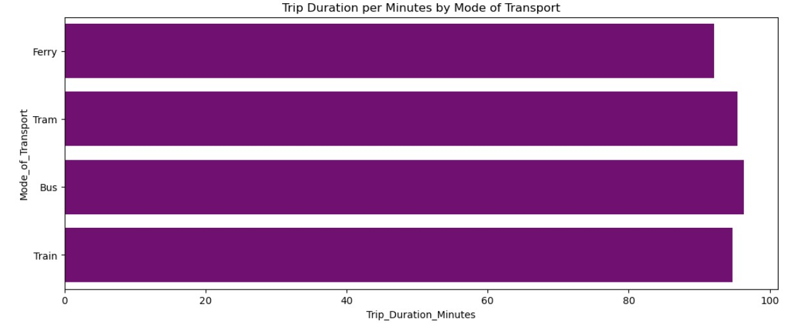
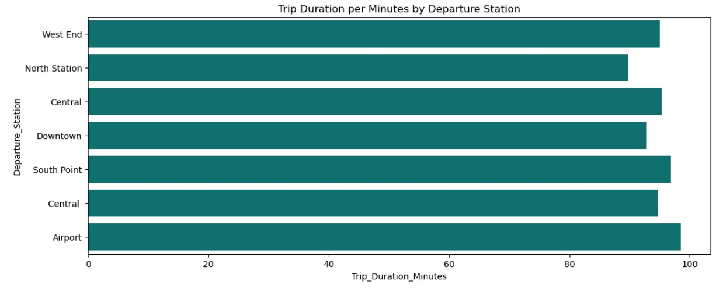
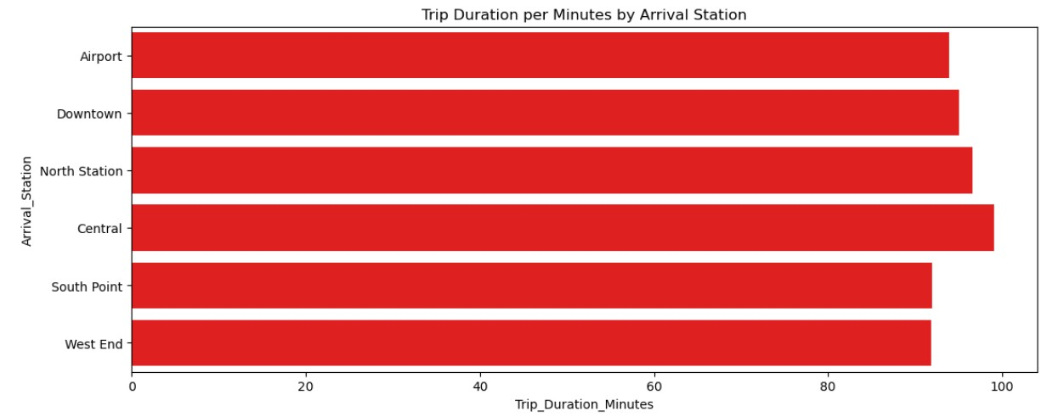
Trip Duration Per Minute By Mode of Transport
Tram: approximately 96 minutes, the longest.
Bus: about 95 minutes.
Train: roughly 94 minutes.
Ferry: close to 92 minutes, the shortest
Trip Duration Per Minute By Departure Station
Trip Duration Per Minute By Arrival Station

Slide 13
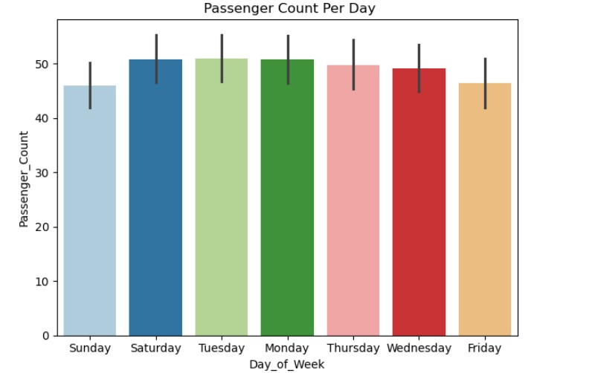
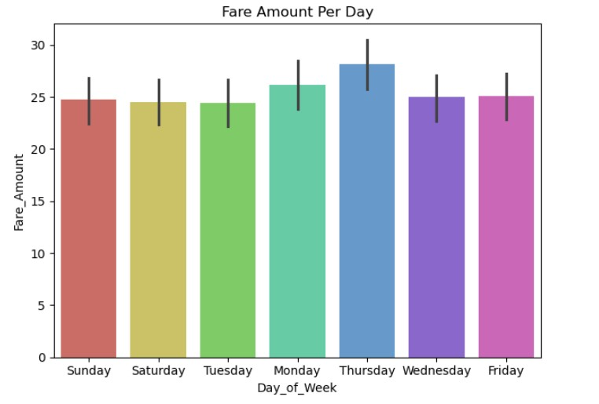
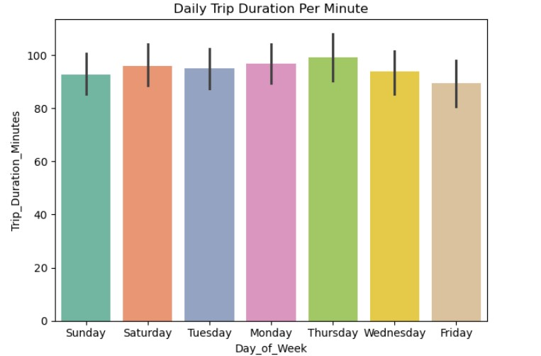
Passenger Count By Days of the Week
Fare Amount Per Day
Daily Trip Duration Per Minute

Slide 14
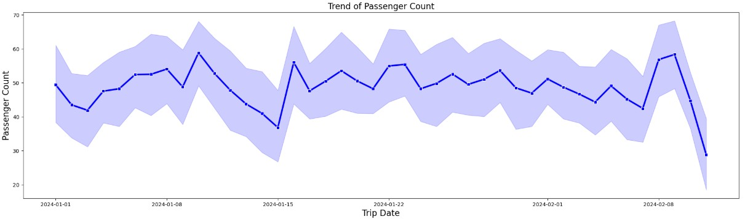
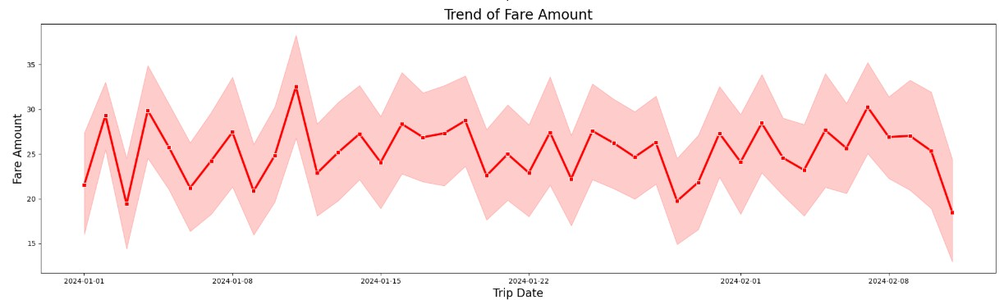
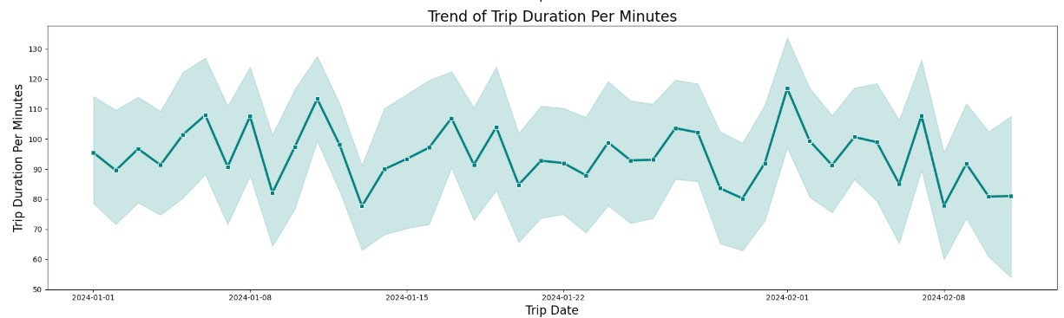
Daily Time Series of Plots Passenger Count, Fare Amount and Trip Duration Per Minute
Trend of Passenger Count Per Trip Date
Trend of Fare Amount Per Trip Date
Trend of Trip Duration Per Trip Dates

Slide 15
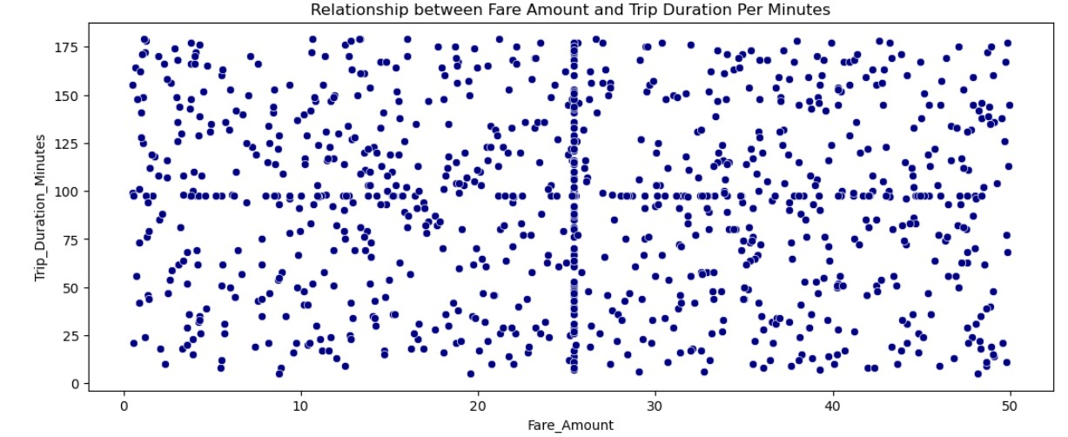
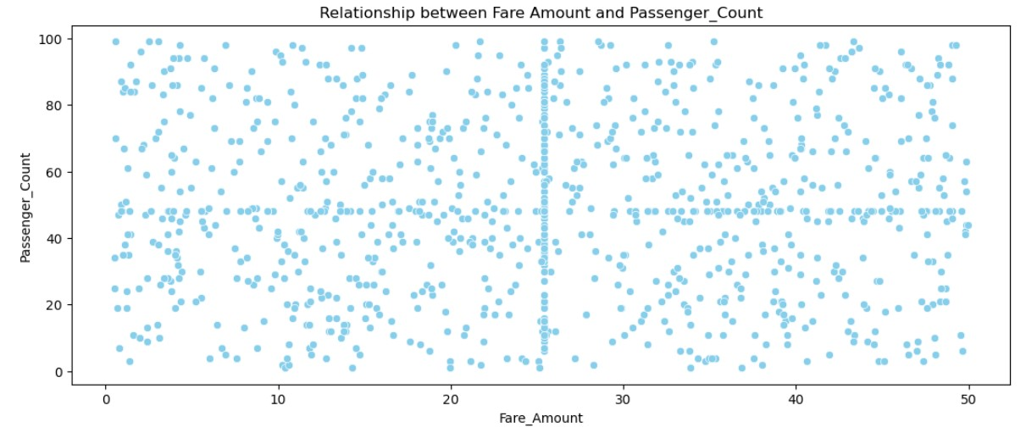
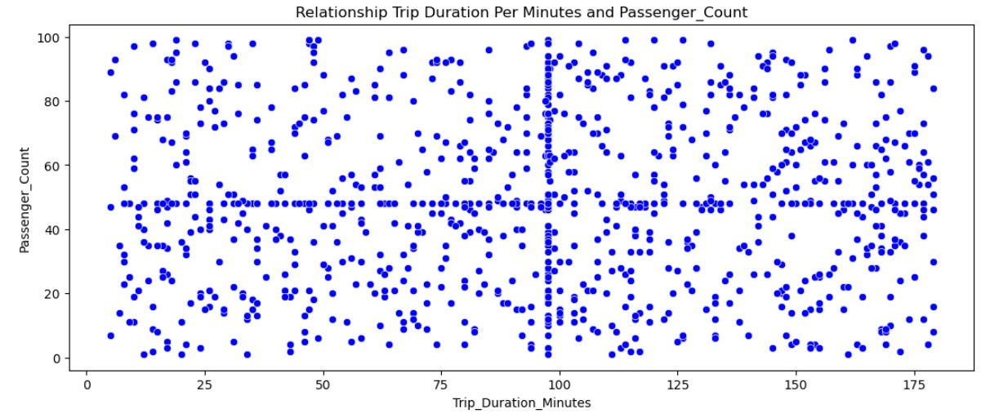
Relationship Plots
Relationship between Fare Amount and Trip Duration Per Minute
Weak correlation
High variability
Influence of external factors:
Relationship between Fare Amount and Passenger Count
Key Insights
Relationship between Trip Duration Per Minute and Passenger Count

Slide 16
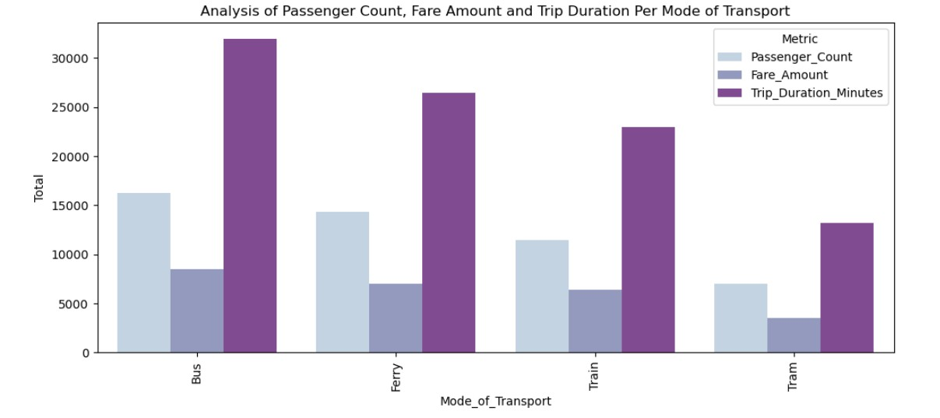
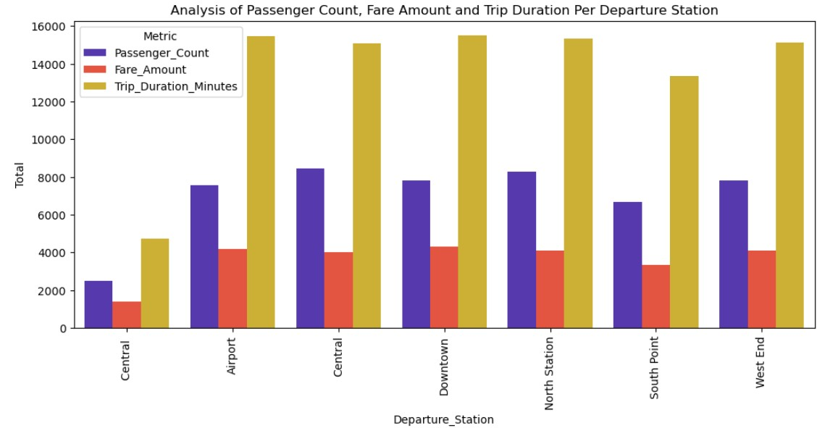
Multivariate Analysis
Analysis of Passenger Count, Fare Amount and Trip Duration Per Mode of Transport
Analysis of Passenger Count, Fare Amount and Trip Duration Per Departure Station

Slide 17
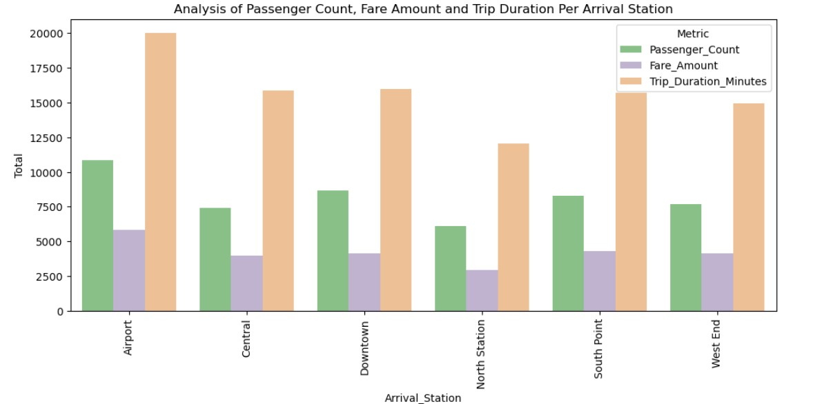
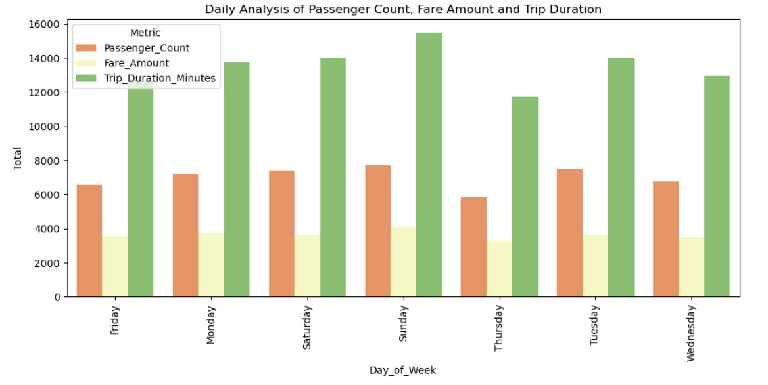
Multivariate Analysis
Analysis of Passenger Count, Fare Amount and Trip Duration Per Arrival Station
Daily of Analysis Trip By Passenger Count, Fare Amount and Trip Duration

Slide 18
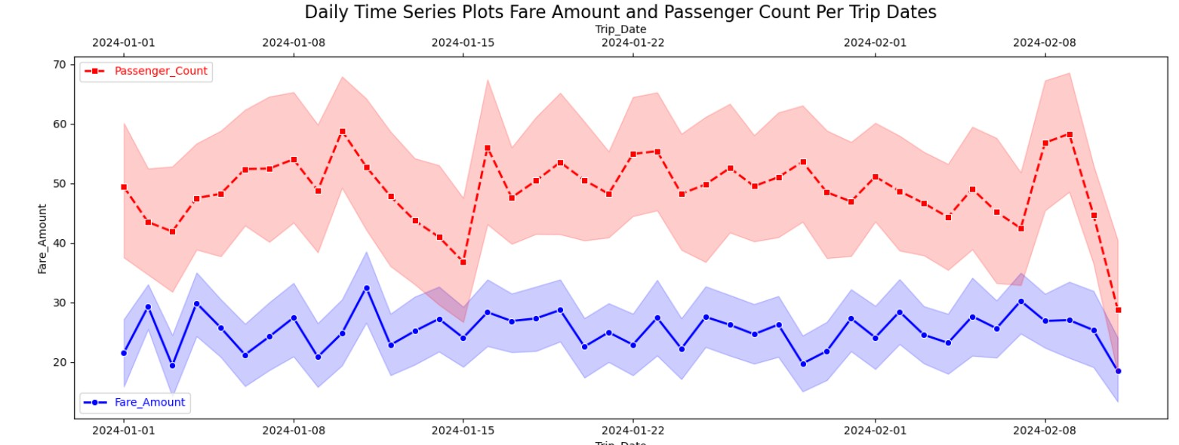
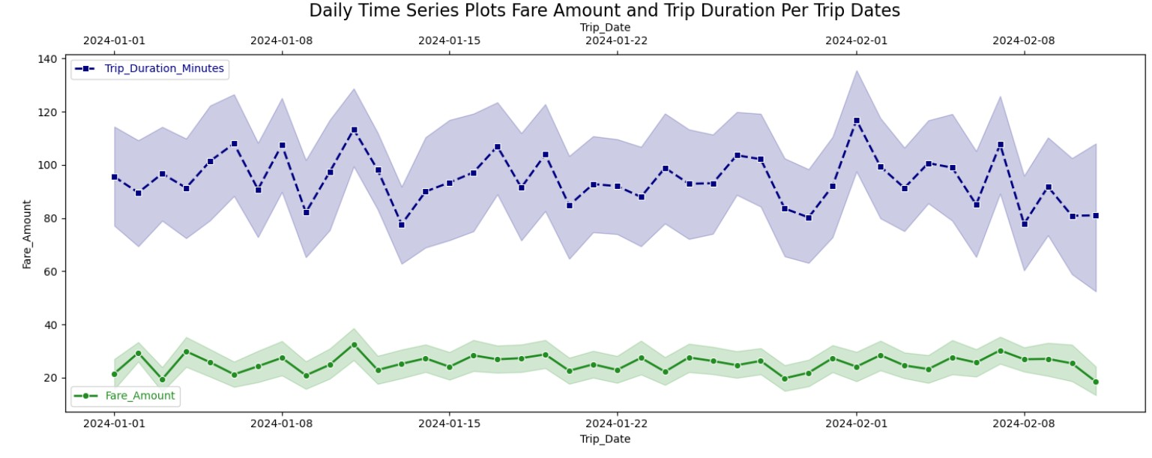
Trend Analysis
Daily Time Series Plot of Fare Amount and Tripe Duration Per Dates
Daily Time Series Plots of Fare Amount and Passenger Count Per Trip Dates

Slide 19
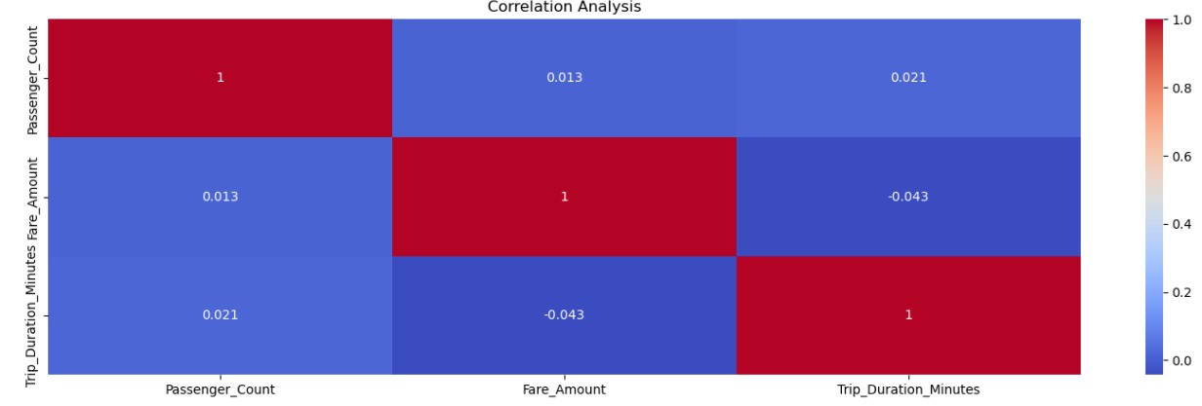
Correlation Analysis

Slide 20
Conclusions and Recommendations
Conclusions
Key Insights
High-Value Corridors Identified
Mode-Specific Demand Patterns
Trip Duration Trends
Network Performance Imbalance
Relationship Analysis
Little Correlation
Fare Pricing
Stable Passenger Volumes
Trend Analysis
Stable Revenue Performance
Weekly Demand Patterns
Operational Challenges
Fair Fare Model
Consistent Operations
Recommendations
Operational Improvements
Capacity and Resource Allocations
Customer Experience Enhancements
Revenue Optimisation
Strategic Planning
Operational Planning
Efficiency Improvements
Revise Fare Policy
Reassess Fare Strategy
Conduct Demand Analysis
Improve Operational Efficiency
Develop Demand Forecasting Models
Enhancing Operational Efficiency
Strengthening Ridership Predictability
Maintaining Pricing Stability
Improve Customer Experience
Data-Driven Operational Reviews

